Slide 1
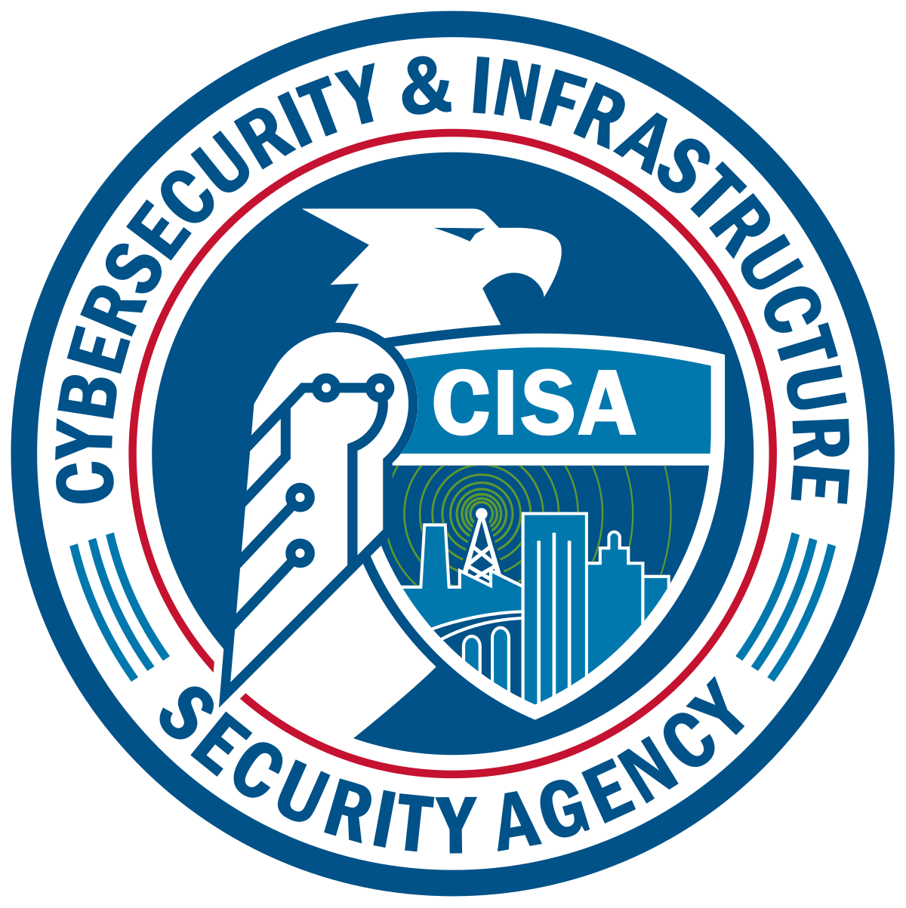
Understanding the Cyber Law: CISA
Team Lead: Neveah C.
Lead Presenter: Jaidan J.
Lead Researcher: Jada H.
Team Collaborator: Ria E.
Team Collaborator: Thomas. B

Slide 2

Outline:
Introduction
History
Key Provisions of CISA
Benefits/Challenges of CISA
Consequences
Business and societal impact
Real-World Case of Studies
Criminal vs Legal appliances
Recommendations for Improvement
References

Slide 3

Introduction
What is CISA?
CISA Law, (Cybersecurity Information Sharing Act) a US 2015 law, enables government and company collaboration to securely share information about cyber threats, enhancing preparedness for attacks.
CISA Agency, (Cybersecurity and Infrastructure Security Agency), a US government agency, focuses on securing critical infrastructure from cyberattacks and providing resources for businesses and individuals to enhance their cybersecurity.

Slide 4
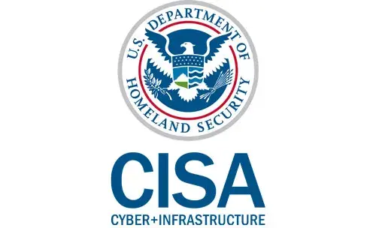
History
it was originally filed as
Pre-CISA (Law):
Restricted information sharing
Lack of preparedness
Why CISA Law and Agency was needed:
The law improved government-private sector for cyber threat information sharing. Enacted in December of 2015.
CISA (Agency) was created to protect the Nation's critical infrastructure from physical and cyber threats. It was signed into law on November 16, 2018.

Slide 5
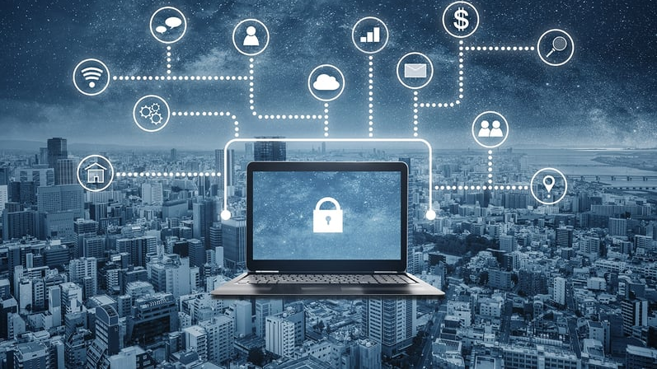
Key Provisions & Regulations
Information sharing
Privacy protections
Enhanced security measures
All information is shared with the CISA Agency, which does not yet enforce penalties for critical infrastructure owners who do not report cyber incidents.

Slide 6
Potential Benefits/Challenges
Benefits of CISA
Faster detection and response to cyber threats
Increased collaboration between government and private sectors
Challenges of CISA
Risk of misuse of shared information
Effectiveness of liability protections

Slide 7

Consequences
Intended Consequences:
Improved Threat Visibility
Faster Incident Response
Unintended Consequences:
Increased Burden on Companies
Privacy Concerns

Slide 8
Business & Societal Impacts
Business Impacts:
Pros: Increased awareness of cyber threats, faster breach response, potential for collaboration with CISA.
Cons: Reporting burden, potential privacy concerns, risk of inaccurate reports.
Societal Impacts:
Pros: Stronger national cybersecurity posture, potentially fewer critical infrastructure outages.
Cons: Potential for increased costs of critical infrastructure services passed on to consumers.

Slide 9
Real-World Case Studies
The case is Murthy v. Missouri it was originally filed as Missouri v. Biden.
The CISA Agency is being charged with protecting non-military networks from hacking and other homeland security threats. It’s a civil case regarding the CISA Agency.
The CISA is also being sued for violating the 1st Amendment.
Since they were trying to push social media platforms to take on more restrictive policies regarding election-related speech by interacting with the app frequently.
The ruling/decision was that CISA did violate the 1st Amendment regarding social media posts.
Both were Civil cases. We couldn't find any cases regarding the Law.

Slide 10
Criminal vs Legal appliances
Criminal Aspects
Collaboration - CISA works alongside criminal law enforcement agencies like the FBI and Secret Service to investigate cybercrime. They provide technical expertise and assist in gathering evidence related to cyberattacks.
Information Sharing - CISA shares cyber threat indicators and intelligence with law enforcement, aiding in identifying and tracking criminal actors.
Legal Preparedness
Incident Response Guidance - CISA's resources on incident response best practices can help organizations collect and preserve evidence legally during a cyberattack. This evidence can be crucial for criminal prosecution.
Cybersecurity Frameworks - CISA promotes frameworks like NIST Cybersecurity Framework, which outlines standards for legal compliance and risk management in cybersecurity.

Slide 11
Improvement Suggestions:
Clarification on Data Sharing
Incentives for Participation
Improved Feedback Loop

Slide 12
References
https://www.cisa.gov/about
https://www.cisa.gov/resources-tools/resources/federal-government-cybersecurity-incident-and-vulnerability-response-playbooks
https://www.cisa.gov/topics/cyber-threats-and-advisories/incident-detection-response-and-prevention
https://www.cisa.gov/topics/cybersecurity-best-practices/organizations-and-cyber-safety/cybersecurity-incident-response
“Cybersecurity Incident Response | CISA.” Cybersecurity and Infrastructure Security Agency CISA, www.cisa.gov/topics/cybersecurity-best-practices/organizations-and-cyber-safety/cybersecurity-incident-response.

